Slide 1
Learning Objective
LO1 Prepare an income statement for a merchandising business organized as a corporation.
© 2014 Cengage Learning. All Rights Reserved.

Slide 2
Uses of Financial Statements
Lesson 16-1
LO1
A corporation prepares an income statement and a balance sheet similar to those used by a proprietorship.
A corporation also prepares a statement of stockholders’ equity.

Slide 3
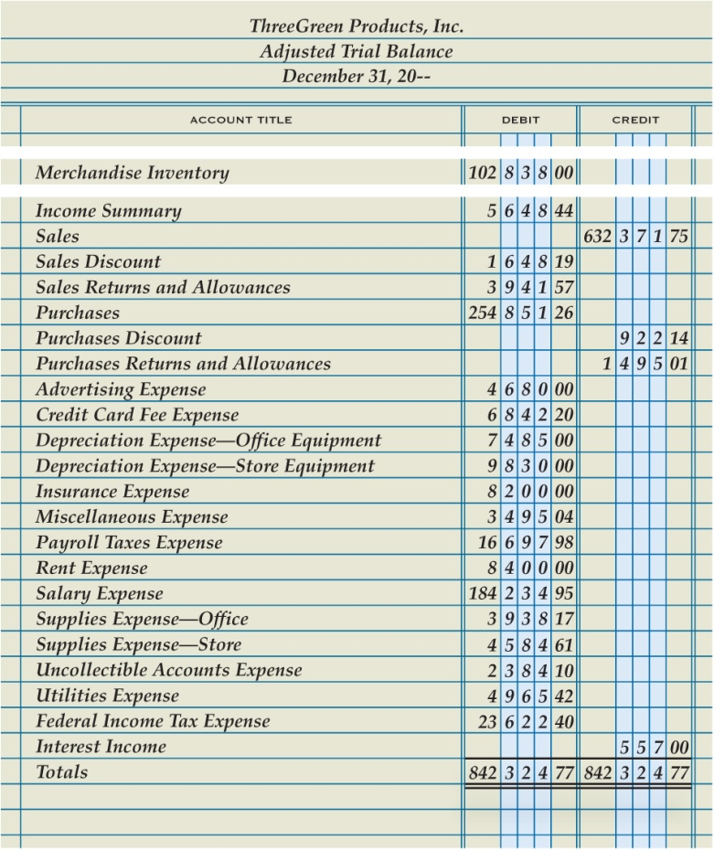
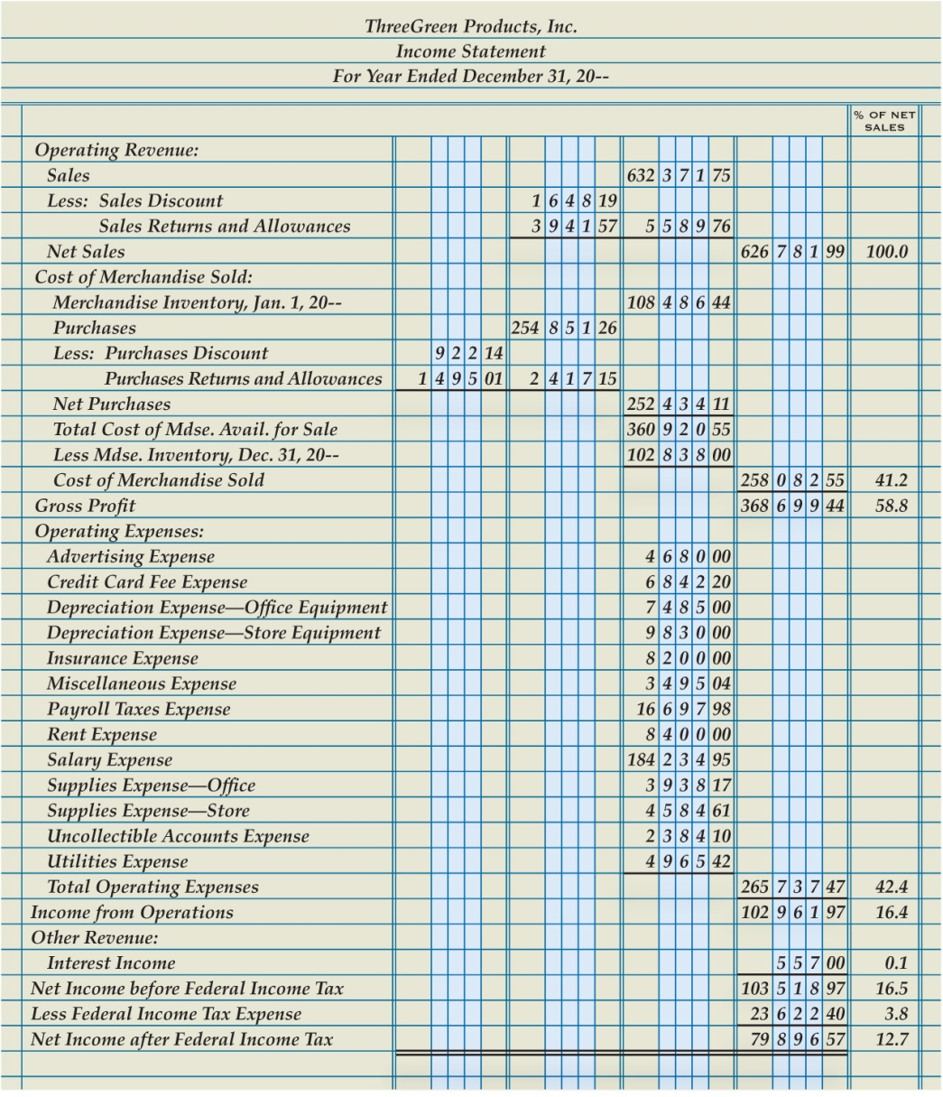
Preparing an Income Statement from a Trial Balance
Lesson 16-1
LO1

Slide 4
Operating Revenue Section of an Income Statement for a Merchandising Business
Lesson 16-1
LO1
The revenue earned by a business from its normal business operations is called operating revenue.
The amount of sales, less sales discounts and sales returns and allowances, is called net sales.

Slide 5
Operating Revenue Section of an Income Statement for a Merchandising Business
Lesson 16-1
LO1
Operating Revenue Section
1
Heading
2
5
Less Contra Accounts
4
Sales Amount
3
Title of Revenue Account
8
Net Sales
Contra Account Amounts
Net Sales
Amount
9
6
Contra Account
Total
7

Slide 6
Cost of Merchandise Sold Section of an Income Statement for a Merchandising Business
Lesson 16-1
LO1
The original price of all merchandise sold during a fiscal period is called the cost of merchandise sold.
Cost of merchandise sold is also known as cost of goods sold or cost of sales.
The operating revenue remaining after cost of merchandise sold has been deducted is called gross profit.
Gross profit is often referred to as gross profit on sales.

Slide 7
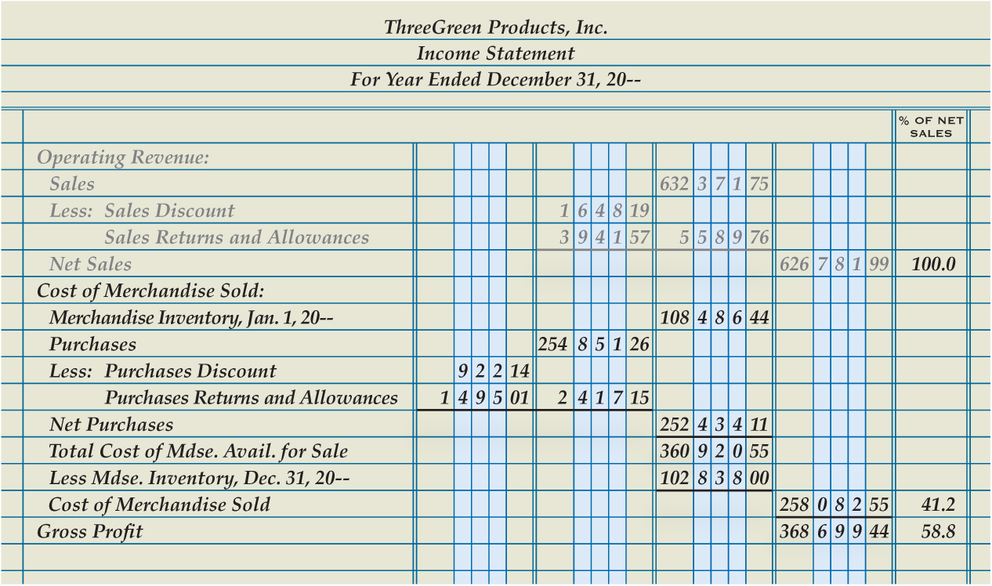
Cost of Merchandise Sold Section of an Income Statement for a Merchandising Business
Lesson 16-1
LO1
Cost of Merchandise Sold Section
Beginning Inventory
Vertical Analysis Percentages
1
2
8
Purchases Section
3
Ending Inventory
5
Gross Profit
7
6
Cost of Merchandise Sold
4
Total Cost of Merchandise Available for Sale

Slide 8
Cost of Merchandise Sold Section of an Income Statement for a Merchandising Business
Lesson 16-1
LO1
Total of adjacent column

Slide 9
Completing an Income Statement for a Merchandising Business
Lesson 16-1
LO1
The expenses incurred by a business in its normal operations are called operating expenses.
The operating revenue remaining after the cost of merchandise sold and operating expenses have been deducted is called income from operations.
Income from operations is also referred to as operating income.

Slide 10
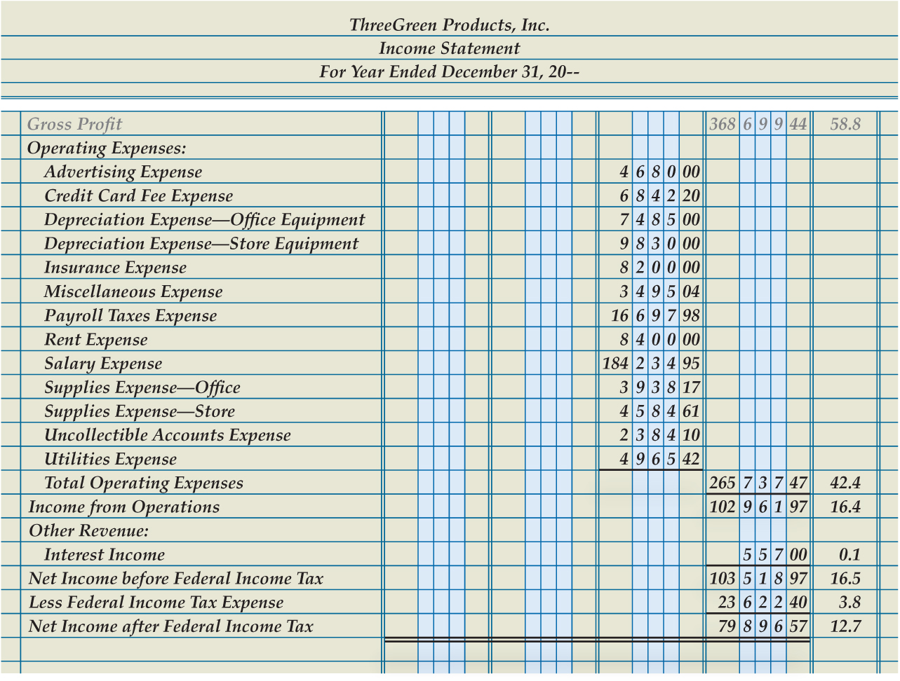
Completing an Income Statement for a Merchandising Business
Lesson 16-1
LO1
Operating Expenses Section
1
8
Vertical Analysis Percentages
Income from Operations
2
Other Revenue Section
3
7
Double Rules
Less Federal Income Tax Expense
6
Net Income after Federal Income Tax
4
Net Income before Federal Income Tax
5

Slide 11
Lesson 16-1 Audit Your Understanding
Lesson 16-1
1. What is the major difference between the income statements for merchandising businesses and service businesses?
ANSWER
The Cost of Merchandise Sold section

Slide 12
Lesson 16-1 Audit Your Understanding
Lesson 16-1
2. How is the cost of merchandise sold calculated?
ANSWER
Beginning merchandise inventory, plus purchases, equals total cost of merchandise available for sale, less ending merchandise inventory, equals cost of merchandise sold.

Slide 13
Lesson 16-1 Audit Your Understanding
Lesson 16-1
3. Why is interest income presented in a section other than Operating Revenue?
ANSWER
The interest earned on notes receivable is not a normal operating activity.

Slide 14
Lesson 16-1
Aplia

Slide 15
Learning Objective
LO2 Prepare a statement of stockholders’ equity for a business organized as a corporation.
© 2014 Cengage Learning. All Rights Reserved.

Slide 16
Stockholders’ Equity Information
Lesson 16-2
LO2
A financial statement that shows changes in a corporation’s ownership for a fiscal period is called a statement of stockholders’ equity.

Slide 17
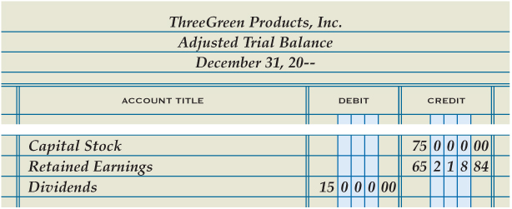
Stockholders’ Equity Information
Lesson 16-2
LO2

Slide 18
Capital Stock Section of the Statement of Stockholders’ Equity
Lesson 16-2
LO2
A value assigned to a share of stock and printed on the stock certificate is called par value.
When issuing shares of stock, a corporation can assign any par value allowed by laws in the state in which it incorporates.

Slide 19
Capital Stock Section of the Statement of Stockholders’ Equity
Lesson 16-2
LO2
2
Capital Stock Section
1
Heading
Stock Issued During the Year
4
3
Stock at Beginning of Year
5
Total Stock Issued

Slide 20
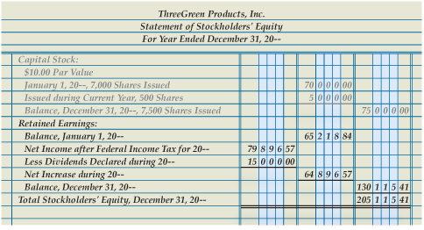
Retained Earnings Section of the Statement of Stockholders’ Equity
Lesson 16-2
LO2
Retained Earnings Section
Net Income after Federal Income Tax
1
3
Beginning Balance
2
Increase in Retained Earnings
5
Dividends Declared
Ending Balance
Total Stockholders’ Equity
4
6
7

Slide 21
Lesson 16-2 Audit Your Understanding
Lesson 16-2
1. What financial information does a statement of stockholders’ equity report?
ANSWER
The changes in a corporation’s ownership for a fiscal period

Slide 22
Lesson 16-2 Audit Your Understanding
Lesson 16-2
2. What are the two major sections of a statement of stockholders’ equity?
ANSWER
Capital Stock and Retained Earnings

Slide 23
Lesson 16-2 Audit Your Understanding
Lesson 16-2
3. Where is the information found to prepare the Capital Stock section of a statement of stockholders’ equity?
ANSWER
In the Capital Stock general ledger account

Slide 24
Lesson 16-2 Audit Your Understanding
Lesson 16-2
4. Where is the beginning balance of retained earnings found?
ANSWER
The Retained Earnings amount on the unadjusted trial balance

Slide 25
Lesson 16-2 Audit Your Understanding
Lesson 16-2
5. Where is net income after federal income taxes found?
ANSWER
The income statement

Slide 26
Lesson 16-2
Aplia

Slide 27
Learning Objective
LO3 Prepare a balance sheet for a business organized as a corporation.
© 2014 Cengage Learning. All Rights Reserved.

Slide 28
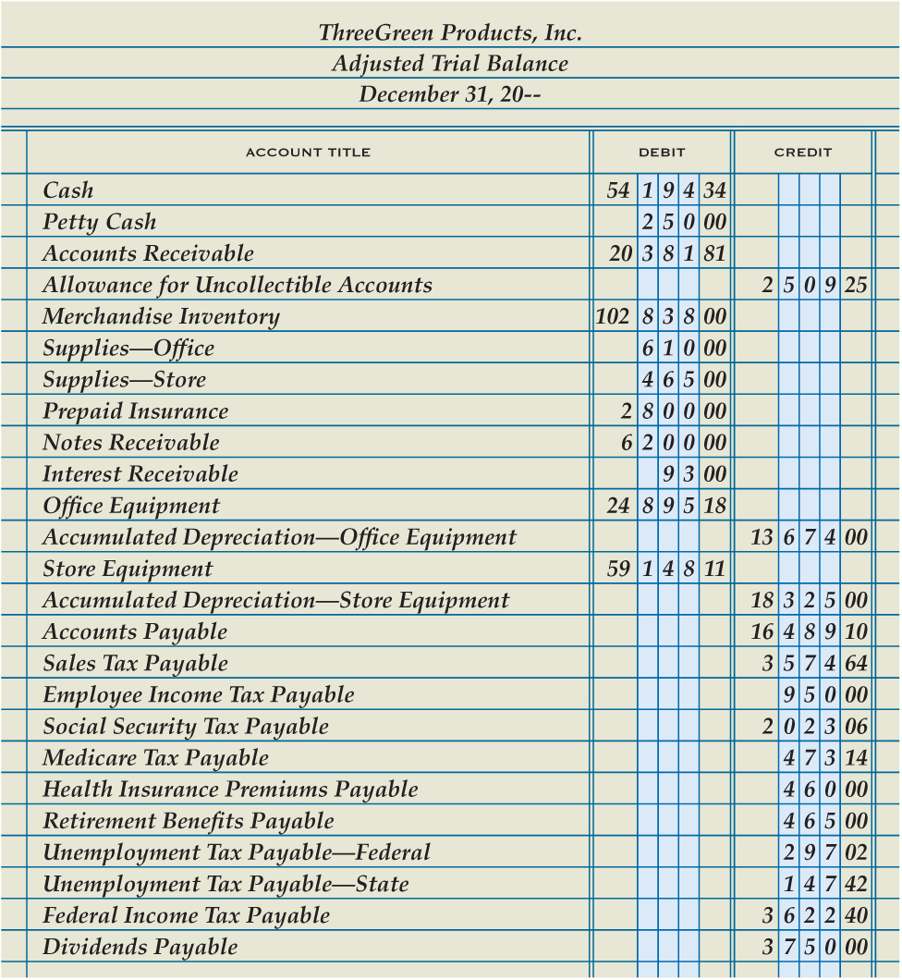
Balance Sheet Information on a Trial Balance
Lesson 16-3
LO3

Slide 29
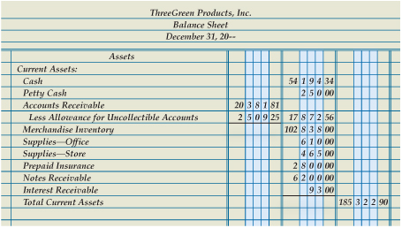
Current Assets Section of a Balance Sheet
Lesson 16-3
LO3
2
Current Assets Section
1
Heading
Book Value of Accounts Receivable
3
4
Remaining Current Asset Accounts
Total Current Assets
5

Slide 30
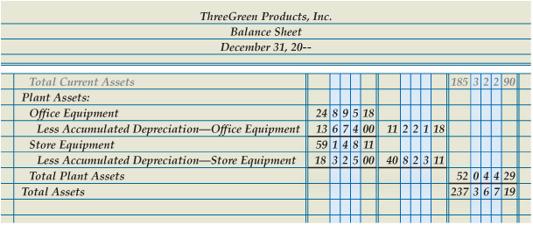
Plant Assets Section of a Balance Sheet
Lesson 16-3
LO3
Plant Assets Section
Book Value of Office Equipment
1
2
Book Value of Store Equipment
Total Plant Assets
Total Assets
3
4
5

Slide 31
Liabilities Section of a Balance Sheet
Lesson 16-3
LO3
Liabilities are classified according to the length of time until they are due.
Liabilities due within a short time, usually within a year, are called current liabilities.
Liabilities owed for more than a year are called long-term liabilities.

Slide 32
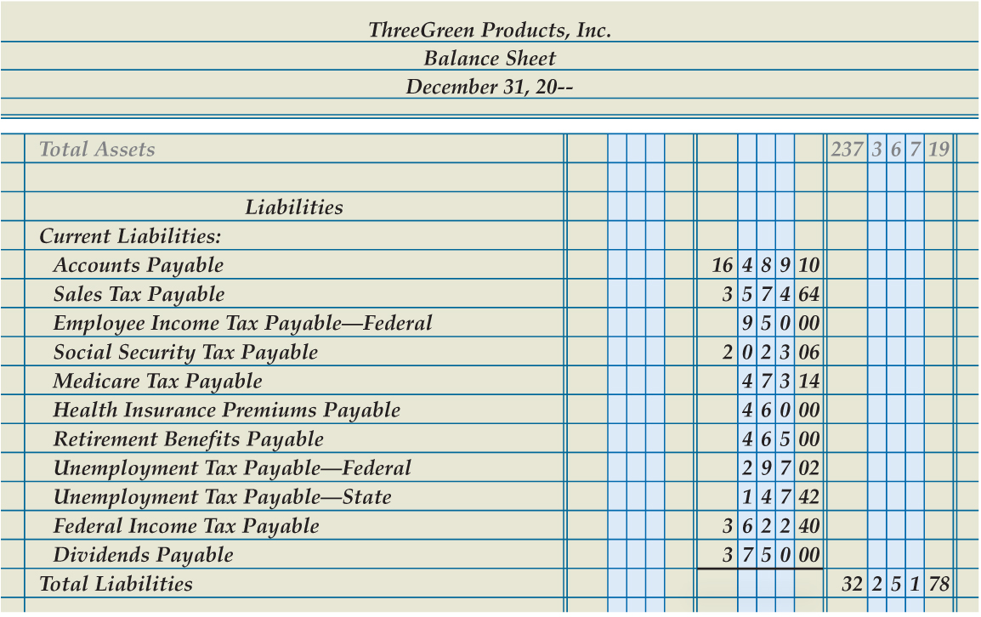
Liabilities Section of a Balance Sheet
Lesson 16-3
LO3
1
Liabilities Section
3
Total Liabilities
2
Account Title and Amount of Each Current Liability

Slide 33
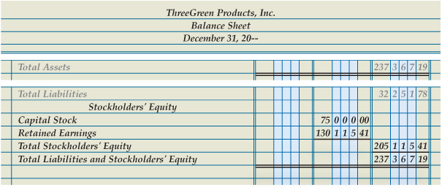
Stockholders’ Equity Section of a Balance Sheet
Lesson 16-3
LO3
Stockholders’ Equity Section
Retained Earnings
1
3
2
Capital Stock
6
Double Rule
Total Stockholders’ Equity
4
5
Total Liabilities and Stockholders’ Equity

Slide 34
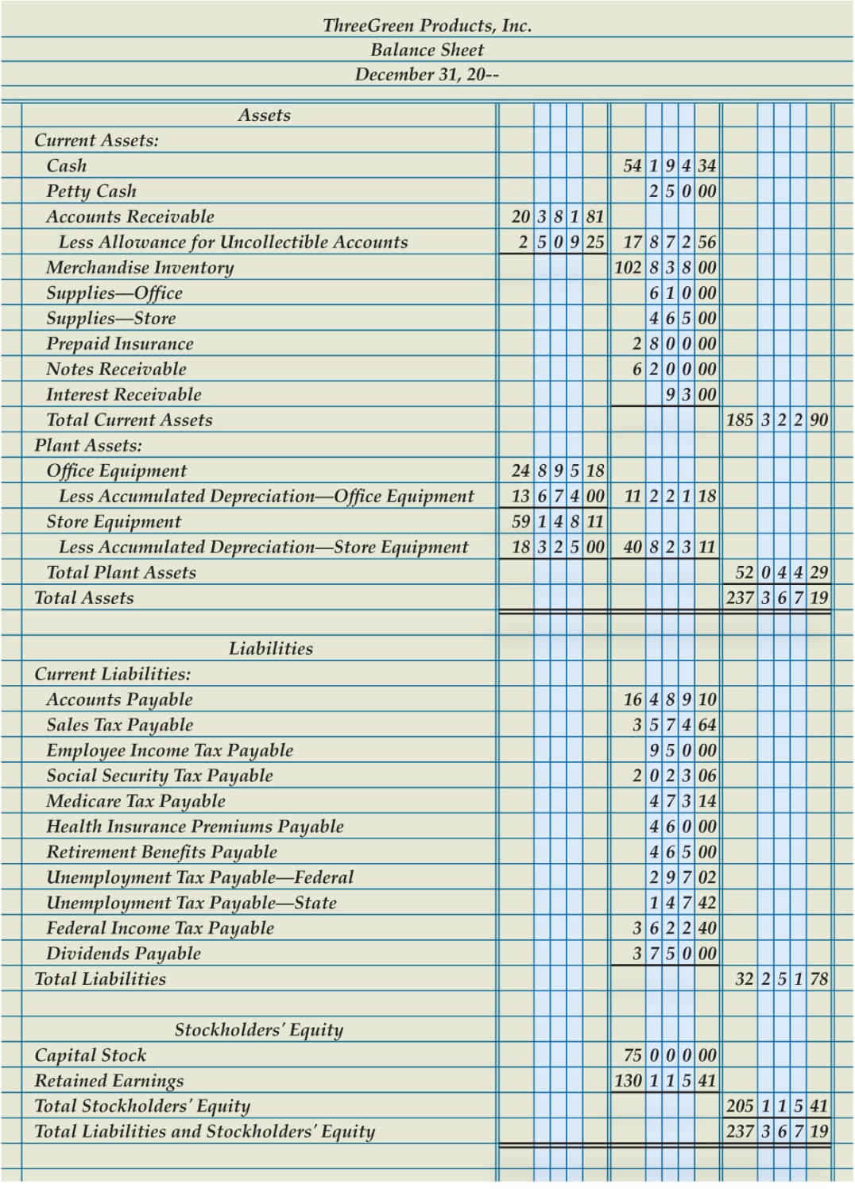
Completed Balance Sheet
Lesson 16-3
LO3

Slide 35
Supporting Schedules for a Balance Sheet
Lesson 16-3
LO3
A report prepared to give details about an item on a principal financial statement is called a supporting schedule.
Schedule of Accounts Receivable
Schedule of Accounts Payable

Slide 36
Lesson 16-3 Audit Your Understanding
Lesson 16-3
1. How does ThreeGreen classify its assets?
ANSWER
Current assets and plant assets

Slide 37
Lesson 16-3 Audit Your Understanding
Lesson 16-3
2. What three items are listed on the balance sheet for an account having a related contra asset account?
ANSWER
The balance of the asset account
The balance of the contra asset account
The book value

Slide 38
Lesson 16-3 Audit Your Understanding
Lesson 16-3
3. What is an example of a long-term liability?
ANSWER
Mortgage payable

Slide 39
Lesson 16-3 Audit Your Understanding
Lesson 16-3
4. Where are the amounts obtained for the Stockholders’ Equity section of the balance sheet?
ANSWER
From the statement of stockholders’ equity

Slide 40
Lesson 16-3 Audit Your Understanding
Lesson 16-3
5. What are two supporting schedules that might accompany a balance sheet?
ANSWER
Schedule of accounts payable and schedule of accounts receivable

Slide 41
Lesson 16-3
Aplia

Slide 42
Learning Objective
LO4 Prepare closing entries.
© 2014 Cengage Learning. All Rights Reserved.

Slide 43
Closing Entries
Lesson 16-4
LO4
A corporation records four closing entries:
1. A closing entry for income statement accounts with credit balances (revenue and contra-cost accounts). (S)
2. A closing entry for income statement accounts with debit balances (cost, contra revenue, and expense accounts). (E)
3. A closing entry to record net income or net loss in the Retained Earnings account and close the Income Summary account. (N)
4. A closing entry for the Dividends account. (D)

Slide 44
The Income Summary Account after Adjusting Entries
Lesson 16-4
LO4
Income Summary
Debit
Expenses
Credit
Revenue -- If revenue is greater than expenses…
(The credit balance is the net income)

Slide 45
Closing Entry for Accounts with Credit Balances
Lesson 16-4
LO4
Sales
Closing 632,371.75
Bal. 632,371.75
(New Bal. 0.00)
Income Summary
Adj. (mdse inv.) 5,648.44
Closing 635,345.90
(credit accounts)

Slide 46
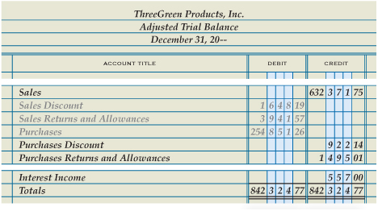
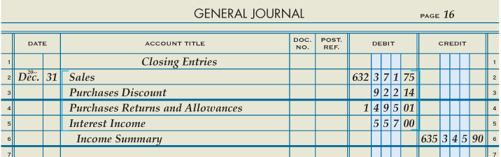
Closing Entry for Accounts with Credit Balances
Lesson 16-4
LO4
Debit to Close
3
3
2
Date
1
Heading
Credit to Income Summary
4

Slide 47
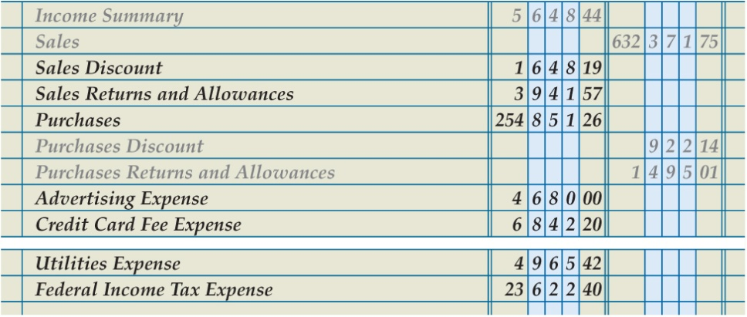
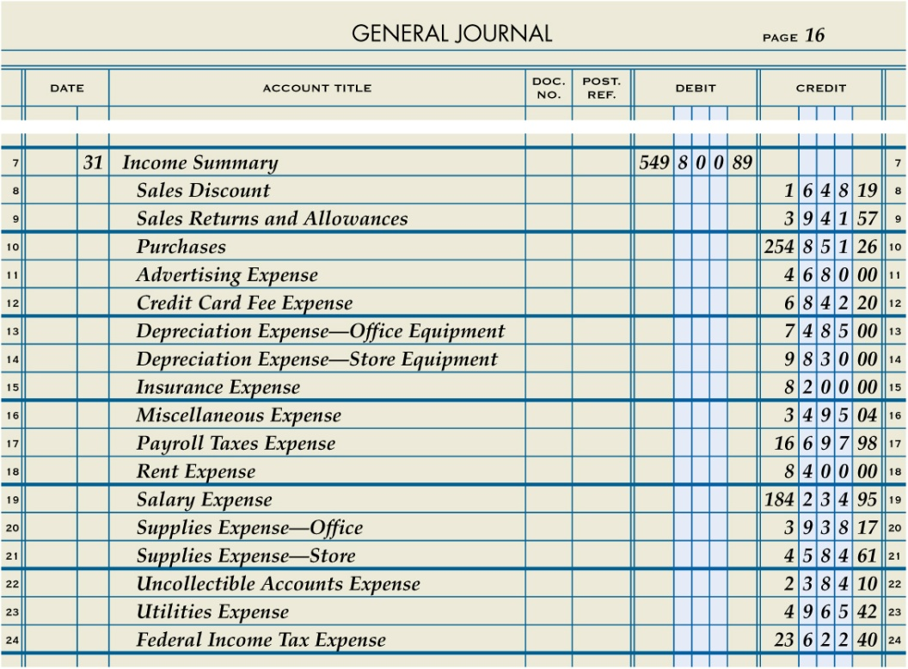
Closing Entry for Income Statement Accounts with Debit Balances
Lesson 16-4
LO4
Credit to Close
3
3
Income summary
Date
1
2
Debit to Income Summary
4

Slide 48
Summary of Closing Entry for Income Statement Accounts with Debit Balances
Lesson 16-4
LO4
Purchases
Bal. 254,851.26
(New Bal. 0.00)
Closing 254,851.26
Income Summary
Adj. (mdse. Inv.) 5,643.44
Closing (debit accounts) 549,800.89
Closing (credit accounts) 635,345.90
(New Bal. 79,896.57)

Slide 49
Closing Entry to Record Net Income
Lesson 16-4
LO4
Income Summary
Adj. (mdse. inv.) 5,643.44
Closing (debit accounts) 549,800.89
Closing (Retained Earnings) 79,896.57
Closing (credit accounts) 635,345.90
(New Bal. 0.00)
Retained Earnings
Closing (credit accounts) 65,218.84
Closing (Retained Earnings) 79,896.57
(New Bal. 145,115.41)
Date
Debit Income Summary
Credit Retained Earnings

Slide 50
Closing Entry for Dividends
Lesson 16-4
LO4
Retained Earnings
Closing (Dividends) 15,000.00
Bal. 65,218.84
Closing (Income Summary) 79,896.57
(New Bal. 130,115.41)
Dividends
Bal. 15,000.00
(New Bal. 0.00)
Closing (Retained Earnings) 15,000.00
Date
Debit Retained Earnings
Credit Dividends

Slide 51
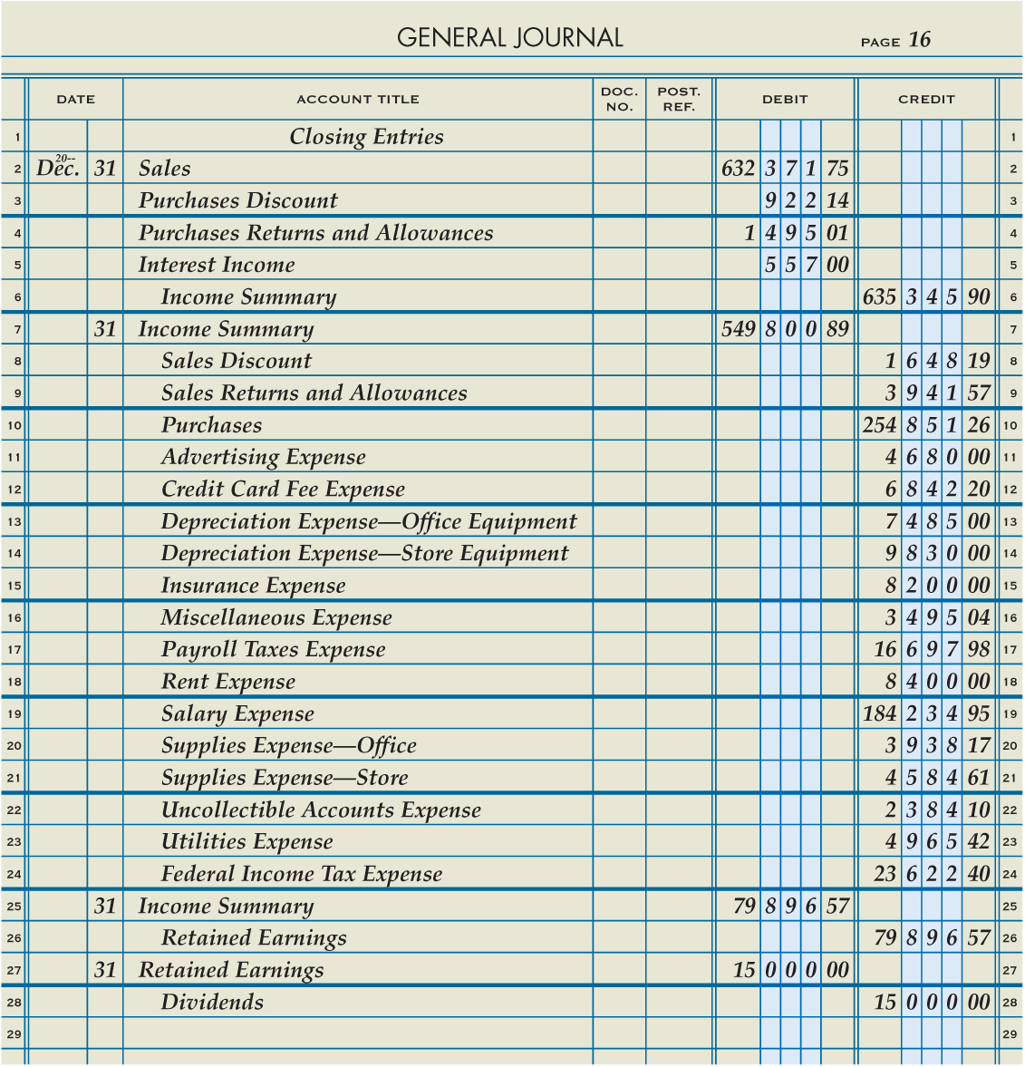
Completed Closing Entries for a Corporation Recorded in a Journal
Lesson 16-4
LO4

Slide 52
Lesson 16-4 Audit Your Understanding
Lesson 16-4
1. Where is the information obtained to journalize closing entries for revenue, cost, and expenses?
ANSWER
From the adjusted trial balance

Slide 53
Lesson 16-4 Audit Your Understanding
Lesson 16-4
2. What is the name of the temporary account used to summarize the closing entries for revenue, cost, and expenses?
ANSWER
Income Summary

Slide 54
Lesson 16-4
Aplia

Slide 55
Learning Objective
LO5 Prepare a post-closing trial balance.
© 2014 Cengage Learning. All Rights Reserved.

Slide 56
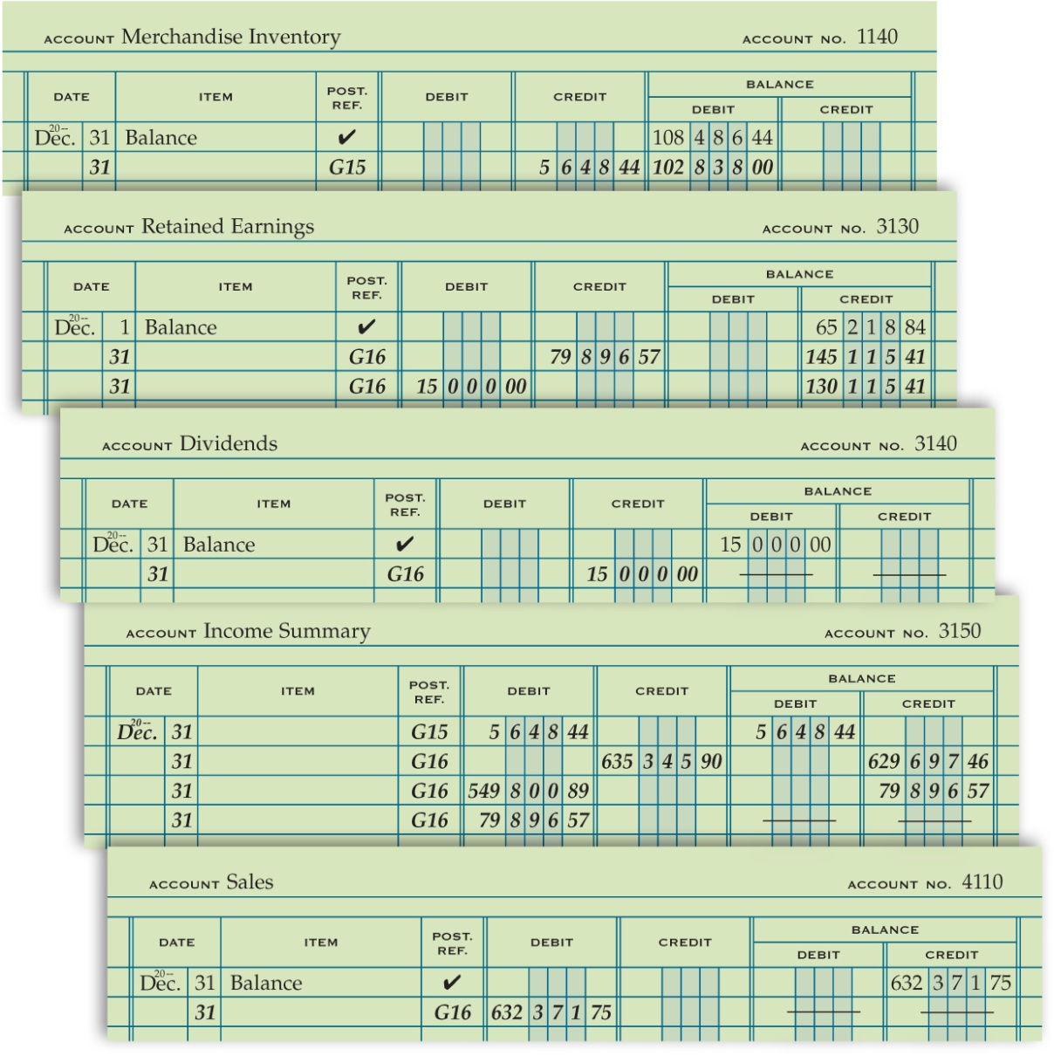
General Ledger After Closing Entries Are Posted
Lesson 16-5
LO5

Slide 57
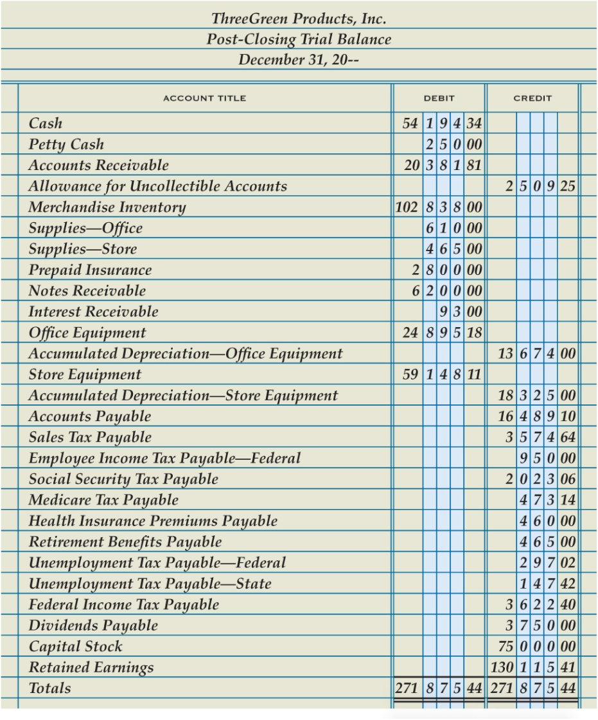
Post-Closing Trial Balance
Lesson 16-5
LO5
1
Heading
Accounts with Balances
Account Balances
2
3
6
Double Rule
Totals
4
Column Totals
5

Slide 58
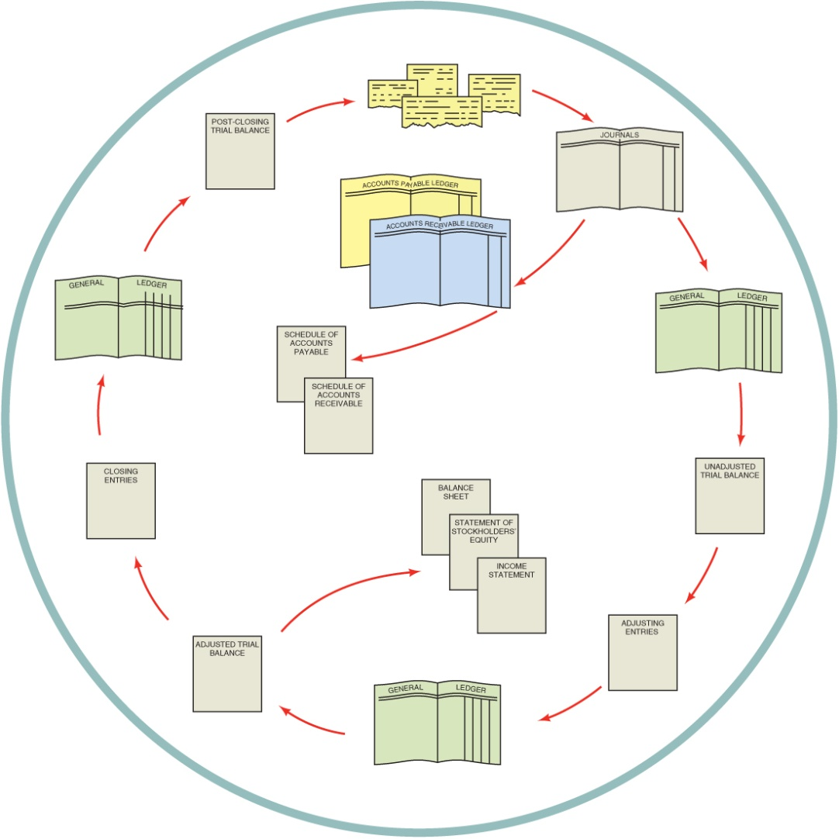
Accounting Cycle for a Merchandising Business Organized as a Corporation
Lesson 16-5
LO5
1. Source documents are checked for accuracy, and transactions are analyzed.
1
2
2. Transactions are recorded in journals.
12
3. Journal entries are posted to the accounts payable ledger, the accounts receivable ledger, and the general ledger.
3
3
4. Schedules of accounts payable and accounts receivable are prepared from the subsidiary ledgers.
4
5. An unadjusted trial balance is prepared from the general ledger.
11
5
6. Adjusting entries are journalized.
9
7. Adjusting entries are posted to the general ledger.
8. An adjusted trial balance is prepared from the general ledger.
10
6
9. Financial statements are prepared from the adjusted trial balance.
8
7
10. Closing entries are journalized.
11. Closing entries are posted to the general ledger.
12. A post-closing trial balance is prepared from the general ledger.

Slide 59
Lesson 16-5 Audit Your Understanding
Lesson 16-5
1. Which accounts and balances are listed on a post-closing trial balance? In what order are they listed?
ANSWER
General ledger accounts that have balances. Accounts are listed in the same order as they appear in the general ledger.

Slide 60
Lesson 16-5 Audit Your Understanding
Lesson 16-5
2. What is the purpose of preparing a post-closing trial balance?
ANSWER
To prove the equality of debits and credits in the general ledger

Slide 61
Lesson 16-5 Audit Your Understanding
Lesson 16-5
3. What two steps in the accounting cycle occur after adjusting entries are posted to the general ledger?
ANSWER
1. An adjusted trial balance is prepared from the general ledger.
2. Financial statements are prepared from the adjusted trial balance.

Slide 62
Lesson 16-5
Aplia

